Slide 1






Agile Project Management

Slide 2




Overview of Agile and Core Principles

Slide 3

  Agile is a flexible, iterative approach to project management focused on collaboration, adaptability, and customer satisfaction.
  Unlike traditional methods, Agile breaks projects into smaller deliverables.

Slide 4

Key Methodologies:
KEY METHODOLOGIES
Scrum:
  Uses time-boxed sprints (e.g., 2 weeks).
  Includes events like daily stand-ups, sprints, backlog, daily scrum, sprint planning, sprint reviews and sprint retrospective.
Lean:
  Eliminates waste, emphasizes value creation,build what is needed and encourages continuous improvement.
Kanban:
  Visualizes tasks on a board (e.g., To-Do, Doing, Done).
  Focuses on continuous flow and reducing work in progress (WIP).
  Extreme Programming (XP):
  Centers on coding excellence and frequent delivery.

Slide 5
Core Principles of Agile
  Individuals and Interactions Over Processes and Tools.
  Working Software Over Comprehensive Documentation.
  Customer Collaboration Over Contract Negotiation.
  Responding to Change Over Following a Plan.
  Why These Principles Matter:
    Agile prioritizes flexibility and value delivery.
    Encourages close collaboration between stakeholders and teams.
Example: A team shifts priorities mid-project to include customer feedback, ensuring better alignment with business goals.
www.reallygreatsite.com

Slide 6
Kanban
Visual Management:
  Tasks are tracked on a board with columns such as "To Do," "In Progress," and "Done."
Principles:
  Visualize work, limit WIP, and focus on continuous improvement.
Advantages:
  No strict iteration cycles.
  Suitable for teams managing ongoing or operational tasks.
Example: Software maintenance team handling bug fixes.
www.reallygreatsite.com

Slide 7
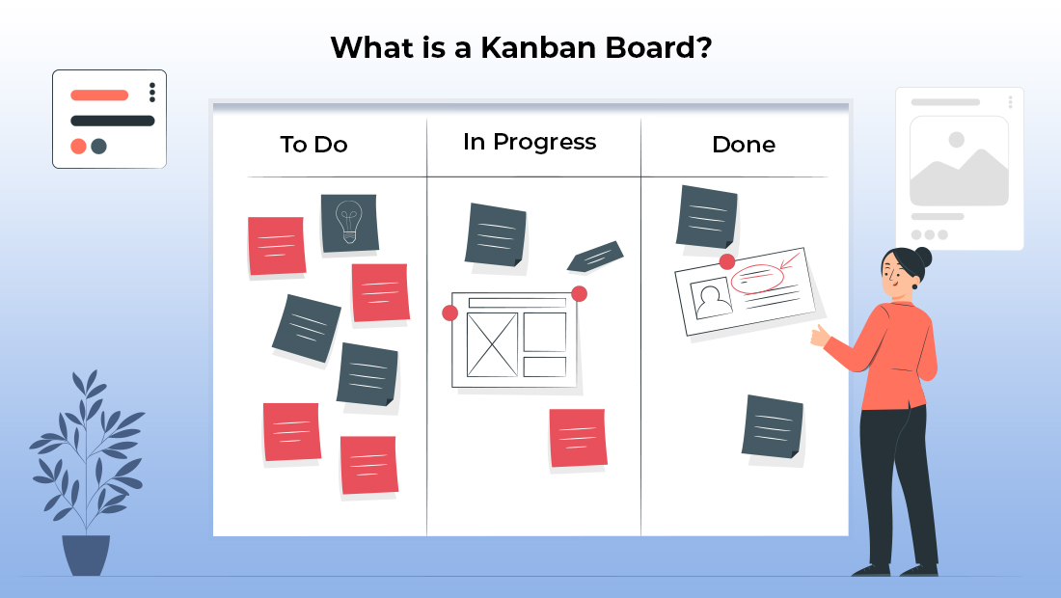
www.reallygreatsite.com

Slide 8
Scrum Iterative Development and Adaptive Planning
Iterative Development
  Definition:
    Delivering work in small, manageable chunks called iterations or sprints.
    Each iteration results in a potentially shippable product increment.
  Benefits:
    Early identification of issues.
    Continuous improvement through feedback.
Example: A team building an online shopping app delivers the login feature in Sprint 1, the product catalog in Sprint 2, and the checkout in Sprint 3.
www.reallygreatsite.com

Slide 9
Adaptive Planning and Responding to Change
What is Adaptive Planning?
    Agile plans are not fixed; they evolve based on feedback and progress.
    Encourages teams to reassess priorities at regular intervals.
  Responding to Change:
    Agile welcomes change even late in the project lifecycle.
    Increases the likelihood of delivering value-aligned outcomes.
Example: A customer requests a new feature after Sprint 2. The team adjusts plans to incorporate it in Sprint 3.
www.reallygreatsite.com

Slide 10
Benefits of Agile's Flexibility
  Faster time to market.
  Higher customer satisfaction.
  Reduced risk by addressing issues early.
  Better alignment with business needs.
www.reallygreatsite.com

Slide 11
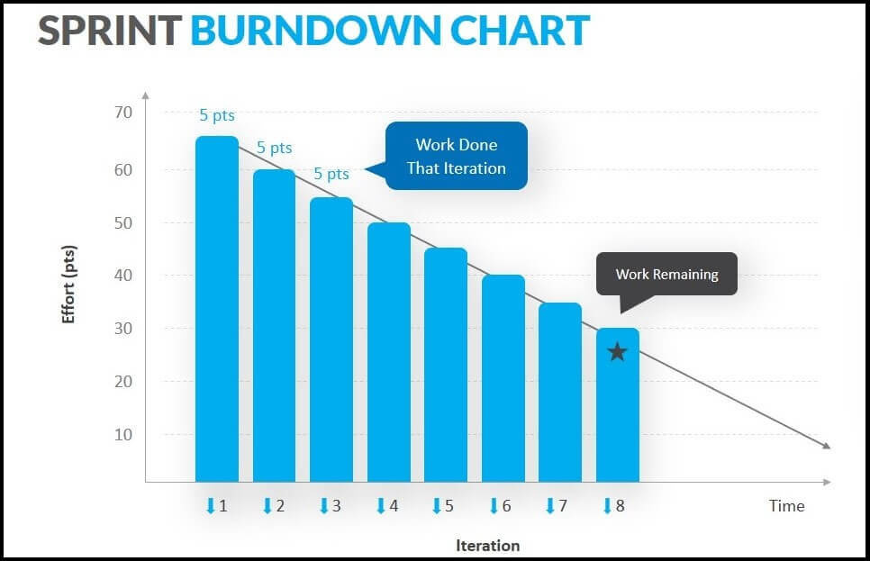

Slide 12
Agile Roles Overview
  Product Owner (PO):
    Manages the product backlog.
    Represents customer interests.
    Prioritizes work based on business value.
  Scrum Master (SM):
    Coaches the team on Agile principles.
    Removes obstacles that hinder progress.
    Facilitates key ceremonies like daily stand-ups and sprint reviews.
  Development Team:
    Cross-functional members who design, develop, and test the product.
    Work collaboratively to deliver product increments.
www.reallygreatsite.com

Slide 13
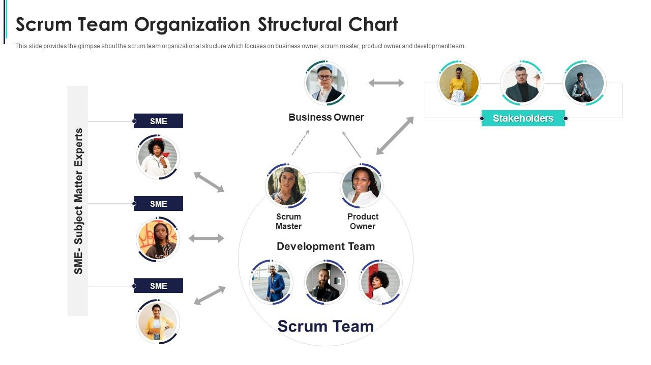

Slide 14
Role of the Product Owner (PO)
  Key Responsibilities:
    Define and maintain the product vision.
    Create, update, and prioritize the backlog.
    Ensure the team understands the customer’s needs.
Example: In a food delivery app, the PO prioritizes adding a “track your order” feature based on customer demand.
www.reallygreatsite.com

Slide 15
Role of the Scrum Master (SM)
  Key Responsibilities:
    Facilitate Agile processes and remove impediments.
    Ensure the team adheres to Scrum principles.
    Act as a servant leader, supporting the team’s productivity.
Example: A Scrum Master resolves a technical dependency blocking the team by coordinating with external stakeholders.
www.reallygreatsite.com

Slide 16
Agile Metrics
  Key Metrics:
    Velocity: Measures the amount of work completed in a sprint.
    Lead Time: Tracks the time from task creation to completion.
    Cycle Time: Focuses on the time to complete a single task.
    Burn-Down and Burn-Up Charts: Visual tools for tracking progress against the sprint goal.
www.reallygreatsite.com

Slide 17
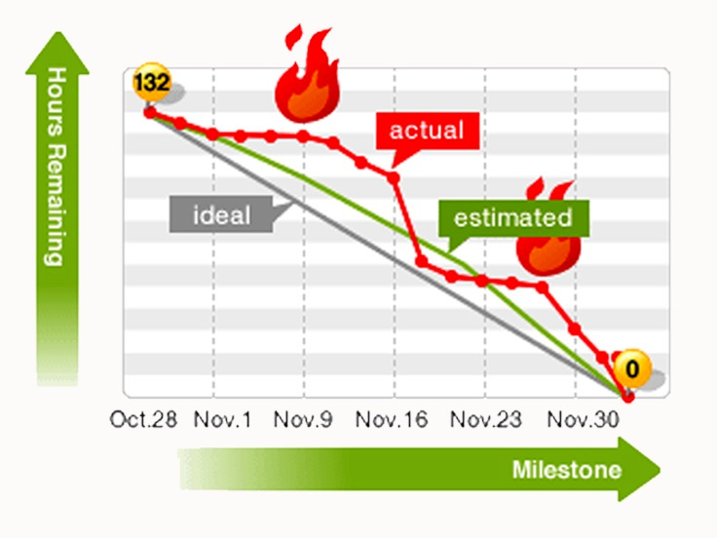

Slide 18
Scaling Agile for Complex Projects
  Frameworks:
    Scaled Agile Framework (SAFe):
      Aligns multiple teams under a common vision and backlog.
    Large-Scale Scrum (LeSS):
      Extends Scrum practices for large teams.
    Disciplined Agile (DA):
      Allows customization of Agile practices for the organization’s needs.
Example: Using SAFe to manage a multi-team project for launching a global product.
www.reallygreatsite.com

Slide 19
Conclusion and Q&A
  Recap Key Points:
    Agile methodologies are flexible, iterative, and customer-focused.
    Agile roles ensure clear accountability and collaboration.
    Metrics and frameworks help teams measure and scale success.
"Which Agile role or practice do you find most interesting and why?"
www.reallygreatsite.com

